Slide 1
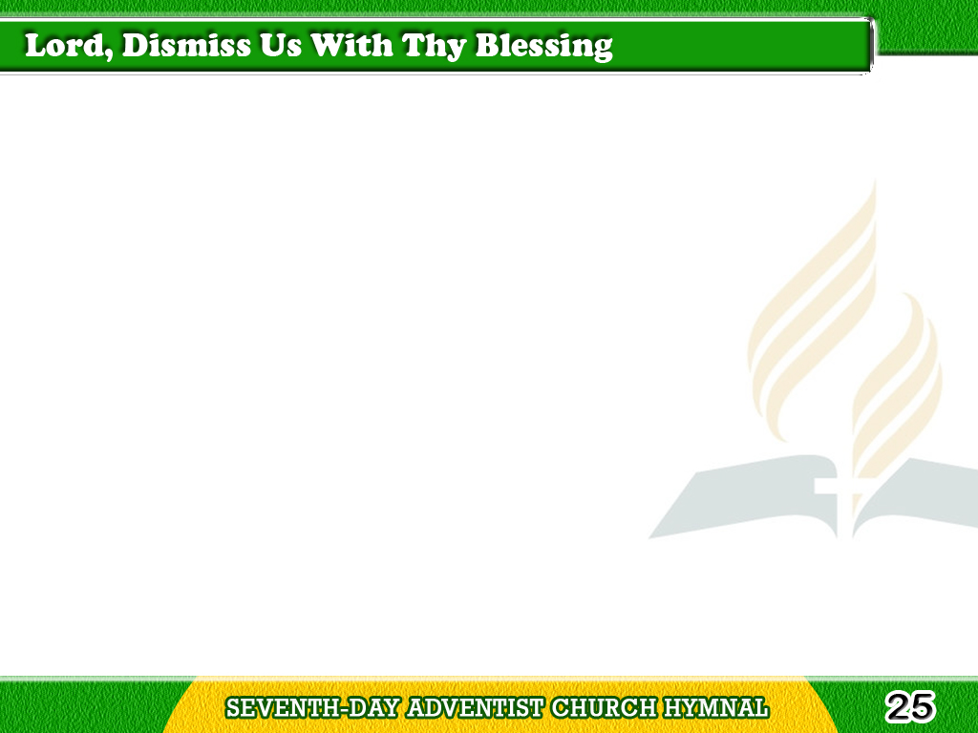
1/2
Lord, dismiss us with
Thy blessing;
Fill our hearts with joy and peace;
Let us each, Thy love possessing,
Tagalog
Version

Slide 2
1/2
Triumph on redeeming grace.
O refresh us, O refresh us,
Traveling through
this wilderness.
Tagalog
Version

Slide 3
2/2
Thanks we give, and adoration,
For Thy gospel’s joyful sound.
May the fruits of Thy salvation
Tagalog
Version

Slide 4
2/2
In our hearts and lives abound.
Ever faithful, ever faithful
To the truth may we be found.
Tagalog
Version

